Slide 1
EUDRACT – How to convert V7 to V8 XML CTA file
Raffaella Chersoni
Compliance and Inspections

Slide 2
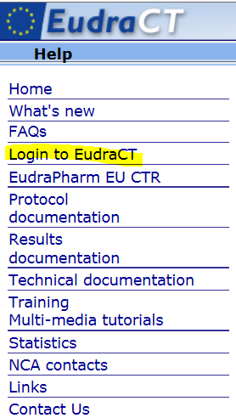
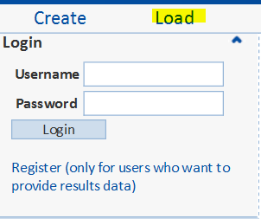
Go to EudraCT public – https://eudract.ema.europa.eu
https://eudract.ema.europa.eu/

Slide 3
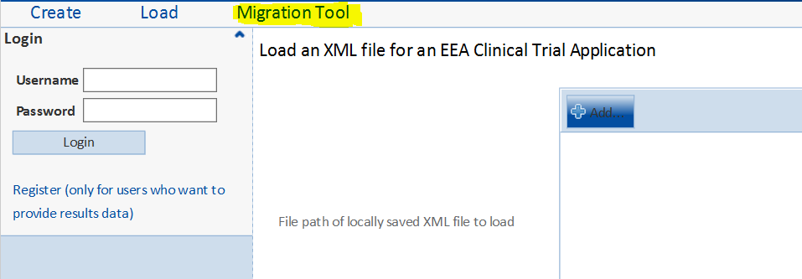
Click on Migration tool

Slide 4
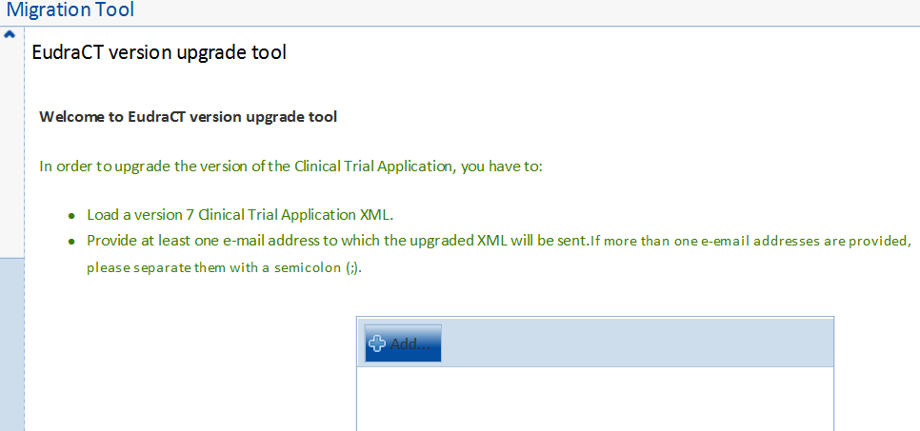
Migration tool screen (1)

Slide 5
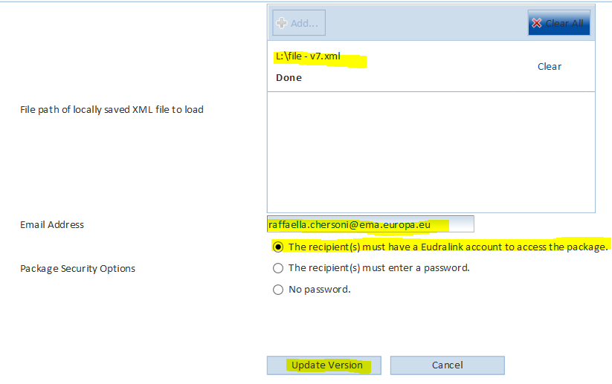
Package Security option - Eudralink

Slide 6
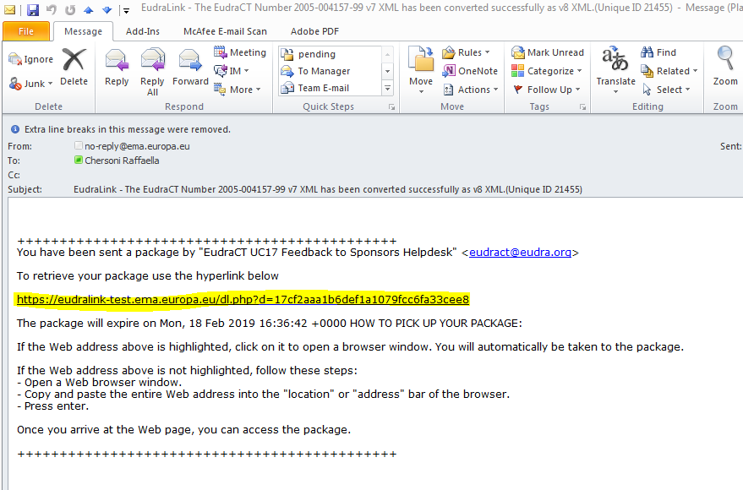
Automated email received in Outlook

Slide 7
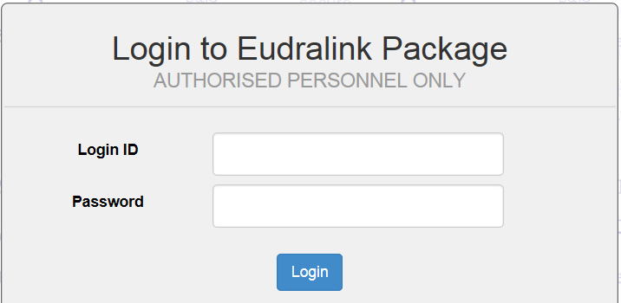
Login to Eudralink package

Slide 8
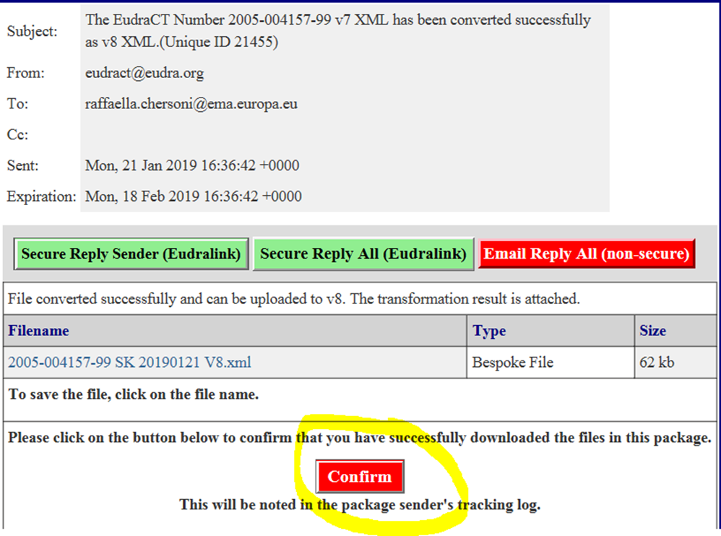
Confirm package

Slide 9
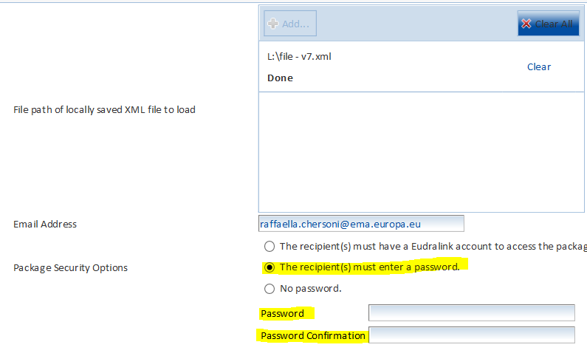
Package Security option - ‘Password’

Slide 10
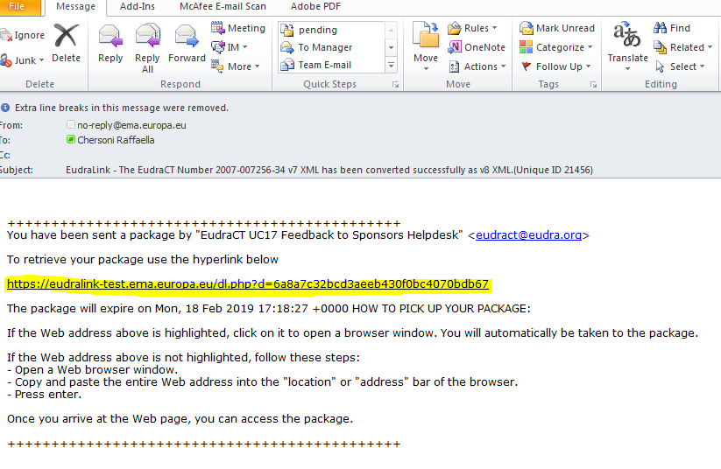
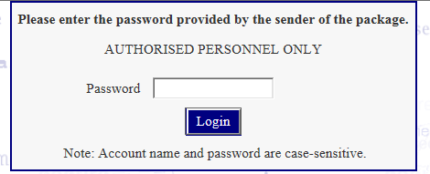
Automated email received in Outlook

Slide 11
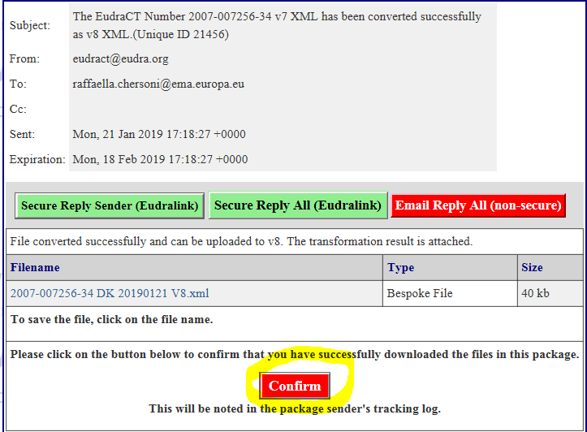
Confirm package

Slide 12
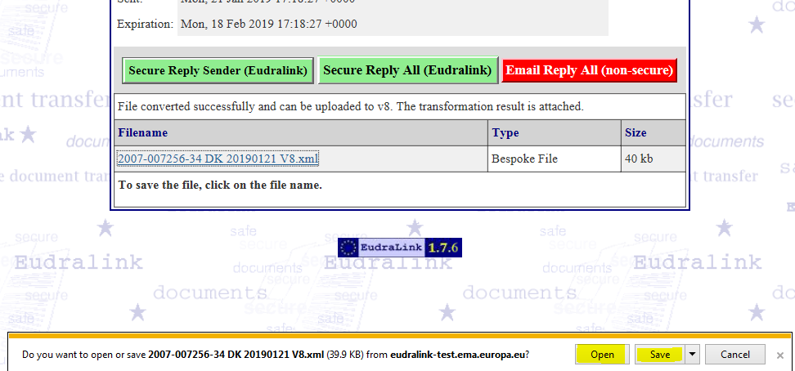
Click on ‘Open’ or ‘Save’

Slide 13
Some highlights
‘no password’ is set as default
The safest and recommended option is via EudraLink
Sponsors can save the converted V8 XML file on own pc for future use.
This feature should be used only for old trials (using old V7 XML file). No need to be used with V8 XML files which is current application form.

